Slide 1
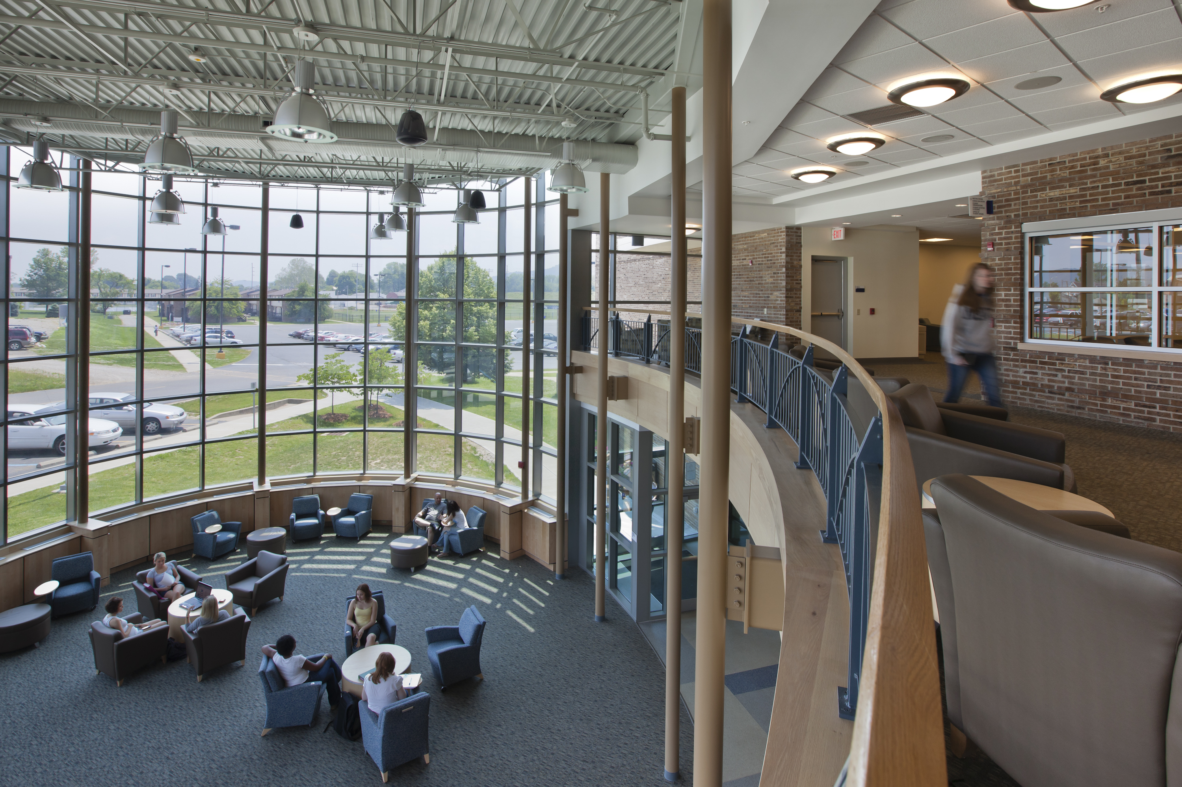
Custodial
Customer Service
Guide
What We Clean & How Often We Clean It

Slide 2
Our Goal
Our goal is to provide the students, faculty, staff, and guests of Shawnee State University a clean and healthy environment. We strive to be aesthetic as well as cost-effective, incorporating recognized housekeeping standards and best practices in everything we do.
With COVID-19 pandemic we have raised our standards even higher, putting new protocols in place to meet the health and safety challenges of this virus.

Slide 3
What to Expect
In an effort to better align services with allocated resources, industry standards and best practices, the custodial staff has been reorganized based on the following priorities:
  Public Areas (Restrooms, Corridors, Lobbies, Stairs, Guest Reception Areas)
  Classrooms, Laboratories, & Conference Rooms
  All other areas (this includes private offices)

Slide 4
Major Changes
No longer servicing offices on a daily basis

Slide 5
Classrooms/Auditoriums
Schedule
FREQUENCY | TASK | DETAILS
DAILY | Empty Trash/Recycling Cans Boards Washed Spot Clean Remove Debris Arrange Furniture | As needed Boards and trays washed as needed in high use areas (i.e. Math Lab) Desks/Tables/Walls/Glass Pick up large debris Straighten as needed
WEEKLY | Clean Surfaces Clean Floors | Door frames & light switches cleaned Vacuum/mop
MONTHLY | Dust – Twice Monthly | HVAC vents, window sills, baseboards, etc.
YEARLY | Scrub Floors/Clean Carpet

Slide 6
Public Areas/Lobbies/Entrances/Hallways/Elevators/Etc.
Schedule
FREQUENCY | TASK | DETAILS
DAILY | Empty Trash/Recycling Cans Water Fountains Glass Clean Floor Remove Debris Furniture | As needed Clean, disinfect, polish Entrance glass cleaned Dust mopped or vacuumed; damp mop when needed Pick up large debris Clean and straighten as needed
WEEKLY | Clean Surfaces | Door frames & light switches cleaned
MONTHLY | Dust | HVAC vents, window sills, baseboards, etc.
YEARLY | Strip/Wax/Scrub Floors/Clean Carpet

Slide 7
Restrooms/Locker Rooms/Showers
Schedule
FREQUENCY | TASK | DETAILS*
DAILY | Empty Trash/Recycling Cans Pick Up Debris Clean Fixtures Clean Floor Common Surfaces Stock Supplies | As needed Large debris removed All fixtures cleaned and disinfected Dust mopped and wet mopped Light switches, door handles, mirrors, cleaned Dispensers are checked and filled as needed
WEEKLY | Scrub Floors
YEARLY | Strip/Wax/Scrub Floors
*Monitored throughout the day

Slide 8
Stairwells/Landings
Schedule
FREQUENCY | TASK | DETAILS
DAILY | Remove Debris Spot Clean | Pick up large debris As needed
WEEKLY | Clean Floor Clean Surfaces Overall Appearance | Dust mopped or vacuumed; damp mop when needed Door frames, handrails, & light switches cleaned Spot-clean walls, scuffs, etc.
MONTHLY | Dust | HVAC vents, window sills, baseboards, etc.
YEARLY | Strip/Wax/Scrub Floors/Clean Carpet

Slide 9
Conference Rooms/Event Spaces
Schedule
FREQUENCY | TASK | DETAILS
DAILY | Remove Debris Clean Boards Clean Furniture Clean Floor Empty Bins Overall Appearance | Pick up large debris Boards and trays wiped Table(s) and chairs wiped down Dust mopped/vacuumed Recycling/trash bins emptied as needed Spot-clean walls, scuffs, etc.
WEEKLY | Clean Surfaces | Door frames, handrails, & light switches cleaned
MONTHLY | Dust | HVAC vents, window sills, baseboards, etc.
YEARLY | Strip/Wax/Scrub Floors/Clean Carpet

Slide 10
Offices
Schedule
FREQUENCY | TASK | DETAILS
THREE TIMES A WEEK *Monday *Wednesday *Friday | Pick Up Debris Clean Floor Dust* Empty Recycling Bins Empty Trash Cans | Large debris removed before sweeping/vacuuming Dust mopped or vacuumed Flat surfaces only – we do not move items Recycling only. All perishable trash should be taken to the receptacles in the hallways/common area as these are monitored and emptied daily or as needed.
YEARLY | Strip/Wax/Scrub Floors/Clean Carpet
*Occupants are responsible for cleaning their desk & any shelves that have “knick-knacks” on them.

Slide 11
Specialty/Auxiliary Spaces
Non-academic areas of specialty/auxiliary spaces will be cleaned on an arranged basis and will incur a departmental chargeback. Those identified are:
  VRCFA
  Rhodes Athletic Center
  CLC
  University owned housing

