Slide 1
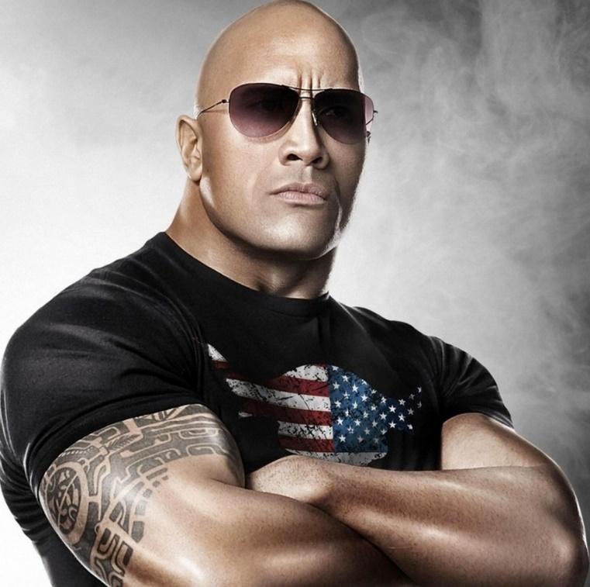
ROCK
YOUR INTERVIEW
Career Services
Massie Hall, Room 124
(740) 351-3027 // careers@shawnee.edu

Slide 2
LEARNING OUTCOMES
Preparing for the interview
During the interview
Following up after an interview

Slide 3
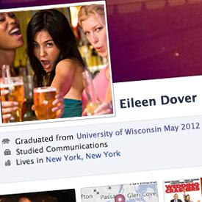
PREPARING FOR THE INTERVIEW
Your life online
Facebook, Twitter, Instagram, LinkedIn
Conduct extensive research
Roles and procedures of company
Practice, practice, practice
Mock Interview

Slide 4
THE INTERVIEW
Look good and dress for the culture
Visit our “Tie-brary” for more information on dressing for success
Bring your career portfolio
Arrive early
Don’t bring your cell phone
Offer a firm handshake
Use proper, comfortable posture
Be aware of your body language

Slide 5
SELL YOURSELF
Be enthusiastic
Explain your qualifications
Relate your experience
Maintain a positive attitude
Make good eye contact
Ask questions

Slide 6
COMMON INTERVIEW QUESTIONS
Tell me about yourself.
What is your greatest weakness?
What are your long-term goals?
Why do you want to work for us?
Why should I hire you?
Do you have any questions?
*Visit the following links for more examples of interview questions:
Traditional Interview Questions
Behavioral Interview Questions

Slide 7
WHAT EMPLOYERS LOOK FOR
Your dependability
Your experience
Good communication skills
Your knowledge of the company and job
How well you get along with others
If you project a positive image
How well you handle challenges

Slide 8
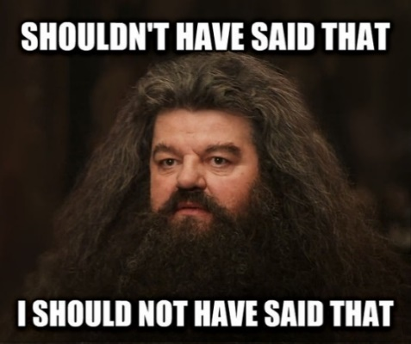
INTERVIEW TIPS
Keep your answers brief, but thorough
Use examples to illustrate your point
Think before you speak
If more time is needed to come up with an answer, repeat the question back to them and follow with your answer
Relate your answers to the job
Don’t bring up compensation

Slide 9
THE CLOSING: ASK QUESTIONS
Have I answered all your questions?
When should I expect to hear from you?/What does your timeline look like?
Stress that you want the job
Ask your interviewer questions!
Thank the interviewer
Let them know you’re excited

Slide 10
EVALUATE YOUR INTERVIEW
Did you dress appropriately?
Were you warm and friendly?
Were you confident?
Were you able to handle tough questions?
Did you project the right ‘fit?’
Did you show you can do the work?
Did you speak well, and to the point?
Did you understand critical points?
Did you project knowledge of the job?
Did you present your qualifications?
Were you enthusiastic?
Did you show your determination?

Slide 11
FOLLOWING THE INTERVIEW
Send a formal thank-you note
Reiterate your qualifications
Stress your enthusiasm
Add ideas you may have forgotten
Evaluate yourself!

Slide 12
QUIZ
Complete this online quiz by clicking on the link & answering the questions
There will be weeks during the semester where we send emails about a drawing for having the quiz completed by a certain date
https://forms.office.com/Pages/ResponsePage.aspx?id=IFyHJnWyD0WMgACyQ421GztZCWXX7PRKk4oe8BUmKAJURUxQWDFGTURCRlo2SUE0TDIwQ0dVOTA3OC4u

Slide 13
CONTACT
See more tips for interviewing on our website!
Career Services
Shawnee State University
MAS 124
Careers@shawnee.edu
(740) 351-3027

