Slide 1
Blackboard Essentials for Beginners
Peggy Whyte
pwhyte@Shawnee.edu

Slide 2
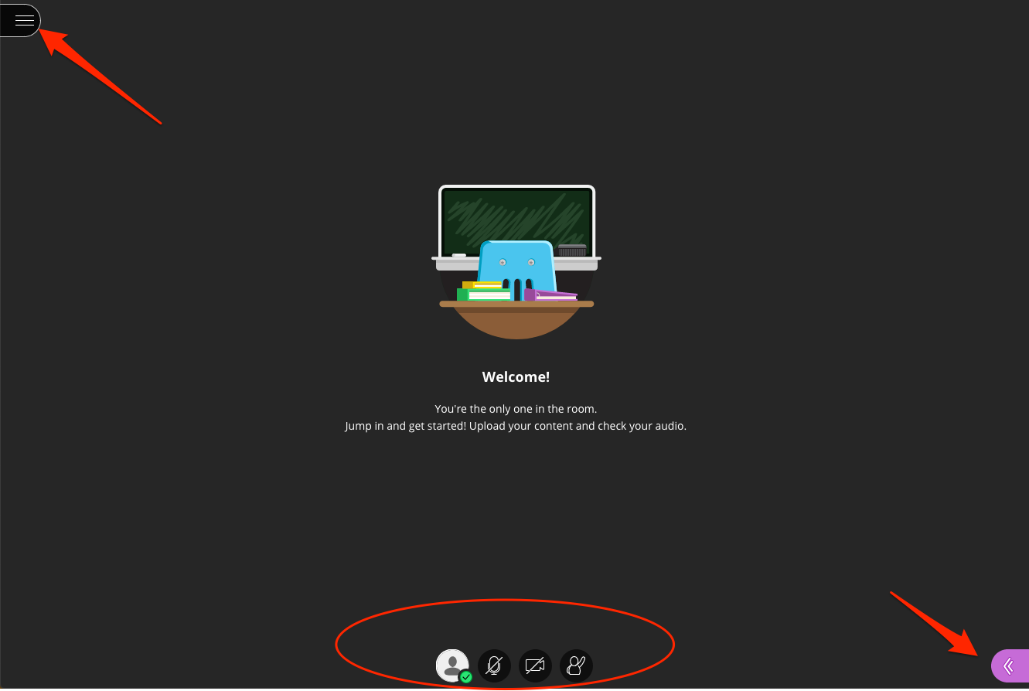

Slide 3
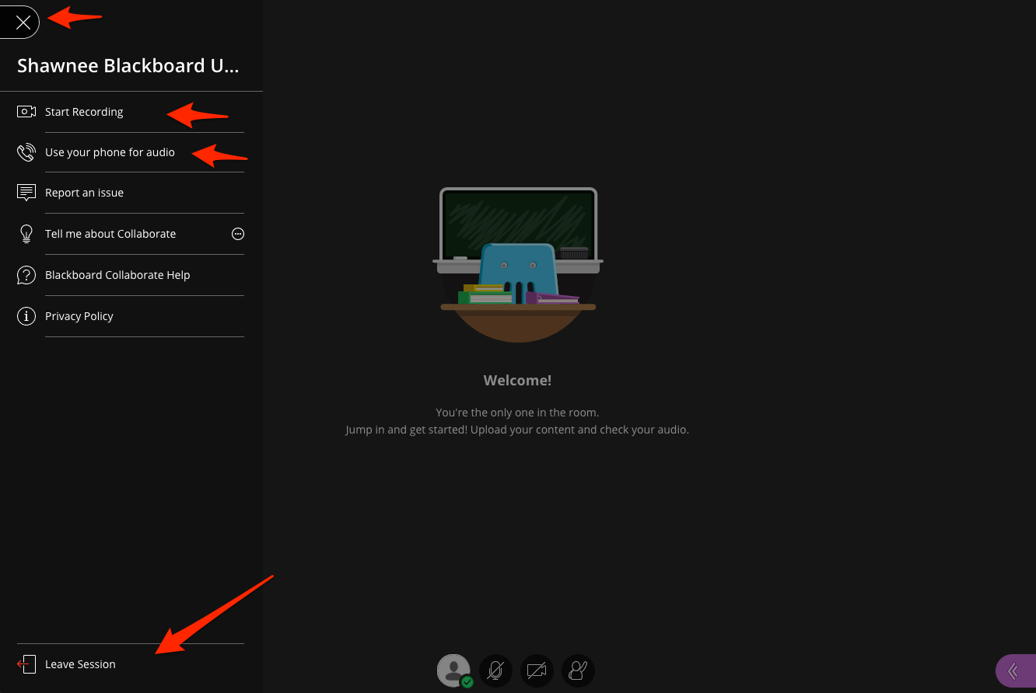

Slide 4
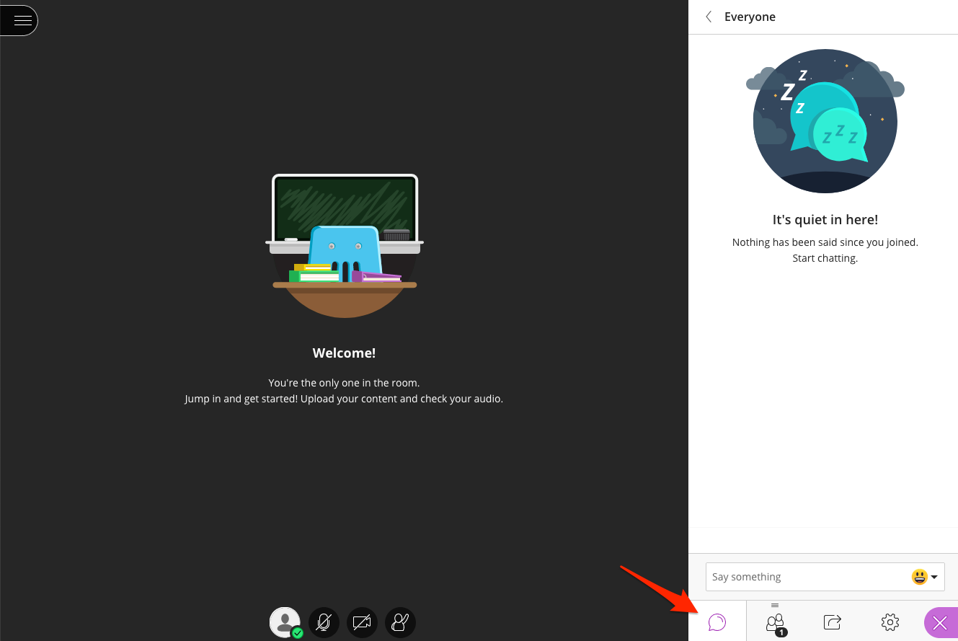

Slide 5
Attend a Collaborate Ultra Workshop!
Thursday, March 12, 10 am – 12 pm
Tuesday, March 24, 10 am – 12 pm
Wednesday, March 25, 10 am – 12 pm

Slide 6
pwhyte@shawnee.edu

