Slide 1
What Now? A Transition Guide to Life After College
Student Career Development
(740) 351-3027
Careers@shawnee.edu

Slide 2
Develop Healthy Habits
Tips for increasing your endurance to help you meet deadlines and survive those overtime days:
Find exercise you enjoy and do it often
Practice good sleep hygiene
Eat well for extra energy!
Read for leisure
Explore different activities and hobbies
Keep in touch with friends from college
Notes:
Not only will this give you endurance, but it will keep you from getting the post-college blues. You will have to work very hard in order to move up, which can be frustrating.
Establish routines
No more staying up until you finish a season of a show on Netflix.
These tips will also help you adjust to the lack of down-time or breaks you had in college. At some jobs, you may not earn days off for up to a year after starting there.
Unplug often – especially if you sit in front of a computer all day.
Consider learning how to cook!

Slide 3
Thinking about grad school?
How will you fund your advanced degree?
Grant/scholarship
Graduate assistant positions
Family loans
Employer education program/advance
Savings
Credit cards
Other expenses:
Housing
Books
Eating
Car maintenance/gas
Laundry
Cell phone
Social events
Will you be responsible for other supplies?

Slide 4
Grad school cont.
Types of Graduate Programs:
Master’s or doctoral (Ph.D.) degree
Explore the curriculum and make sure you understand the requirements
Web-based grad programs
Will you make more money?
Are you going because…
Want to avoid financial/personal problems?
Nervous about conducting a job search?
You’re not sure what you want to do yet
You would like to live in a certain place
You’re curious about a field, but don’t really know anything about it
Is the degree transferrable?
Notes:
Will it make you marketable in your chosen field, or just over-qualified?
Ask others in their field what they think
Is there something you have considered/don’t know about that you could use your current/almost degree for?
- Are you afraid b/c you do not think the idea is good enough or it is too creative/not definite?
Degree transferability – could you apply it to different job opportunities (i.e. MBA)

Slide 5
Grad School: Is now the right time?
Benefits of entering a graduate program immediately after completing your bachelor’s:
You know how you like to study
You may not have many personal responsibilities
You may need to earn an advanced degree for "entry-level" positions in your field
Benefits of waiting to go to grad school:
Some graduate programs explicitly state they are looking for candidates with work experience (or may suggest it)
You will have more life experience to apply to what you learn
Some employers offer tuition benefits
You can save money to fund the experience you want to have
you can improve your chances for acceptance to graduate programs -- especially if you were not the best student in your undergraduate program
Notes:
Having experience in the field can actually increase your chances of being admitted!

Slide 6
Grad School: Organize your school search!
Make a checklist for each school’s application requirements:
Name of school and program
Location
Type of program (i.e., doctorate or masters, research or course-based)
Program length
Application deadline
Costs (tuition, living expenses and other fees)
Admission requirements (i.e.minimum GPA, prerequisites)
Mandatory supplemental documents:
Number of reference letters
Writing samples
Research or area of interest statement
Resume or CV
Completion of required standardized tests (and suggested scores)
Other notes (i.e. information about department faculty, fieldwork opportunities)
Helpful links to admission requirements
**Tip: Organize your list by deadline date
Excel file with schools you have applied to or communicated with:
Who you spoke with or emailed
Date the communication took place
Date accepted or rejected
Notes:
When you have all the schools you are considering listed, try ranking them based on requirements and personal opinion
You may want to explicitly list programs that go through the summer

Slide 7
What If…
Grad school isn’t for me?

Slide 8
Budgeting
The numbers on that first paycheck can be tempting, but creating financial hardship will make the transition from college to work extra challenging.
Create a budget:
Identify spending habits
Take into consideration new expenses
Be careful with student-loan debt:
Understand your repayment options
Make payments on time
Do not take on other debt if possible (i.e. credit cards)
Notes:
You can use old bank statements to find your spending pattern
Especially if you will be on your own for the first time, you will want to spend time balancing a budget.

Slide 9
The First Day at Your New Job
DO:
Participate in opportunities to socialize with coworkers (i.e. going out to lunch the first day)
Pay attention to any training and ask questions!
Do NOT:
Show up late or leave early
Check or use your cell phone all day
Avoid completing tasks on the first day (it’s okay if you need help, this will show you are making an effort)
Get involved in gossip
Notes:
Get to know each person’s responsibilities (this will help you if you need their expertise!). Collaboration is key, so getting to know your colleagues will help you work as part of the team.
Even if you feel very experienced in the field you are entering – you don’t know everything! Ignoring training could set you up for failure on your first day. Don’t let your pride get in the way of doing a great job!! It looks good to ask questions
Unlike in college, you cannot avoid having to show up at certain time – you most likely will not set your own schedule. Your boss will not be forgiving about you being late for work, especially when just starting out.

Slide 10
Workplace Basics
Dress for Success!
Know how to dress for the environment
When buying new items, keep in mind:
Neutral and solid-color pieces
Quality over quantity
Accessories to dress up different pieces
Material (will it need to be dry cleaned?)
Try setting aside outfits for the week

Slide 11
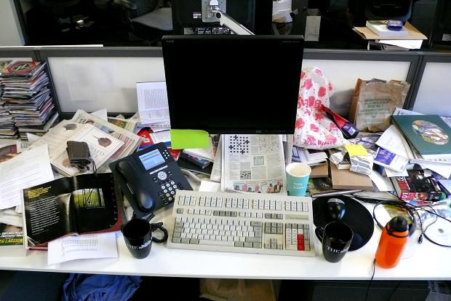
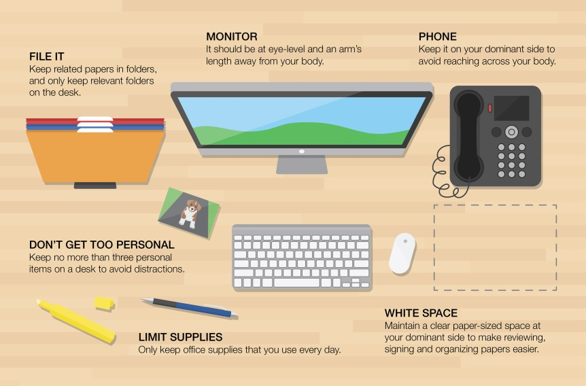
Workplace Basics
Organize Your Desk!
An organized workspace will:
Increase your productivity
Help you remember important events/deadlines
Keep you focused on work goals
Improve your professional appearance
* Bonus Tip: Peruse professional sites or Pinterest for creative organization ideas that fit how you use your workspace.

Slide 12
Workplace Basics
Shared Workspaces:
Let coworkers know about large printing or copying projects in advance
Report any equipment you break (you might even learn how to fix it in case it happens again!)
Do not stockpile shared office supplies

Slide 13
Workplace Basics
Communicating in a Professional Manner:
Do not use slang
Participate in meetings
Listen to your coworkers and your boss
Expand your vocabulary!
Take note of unfamiliar words and research later
Be sure to ask about any terms used specifically for your responsibilities

Slide 14
Workplace Basics
Respect your boss and colleagues
Be honest
Maintain a positive attitude
Make sure you appear approachable
Control strong emotions
Be receptive to feedback
Know when to address conflicts directly and when to involve HR

Slide 15
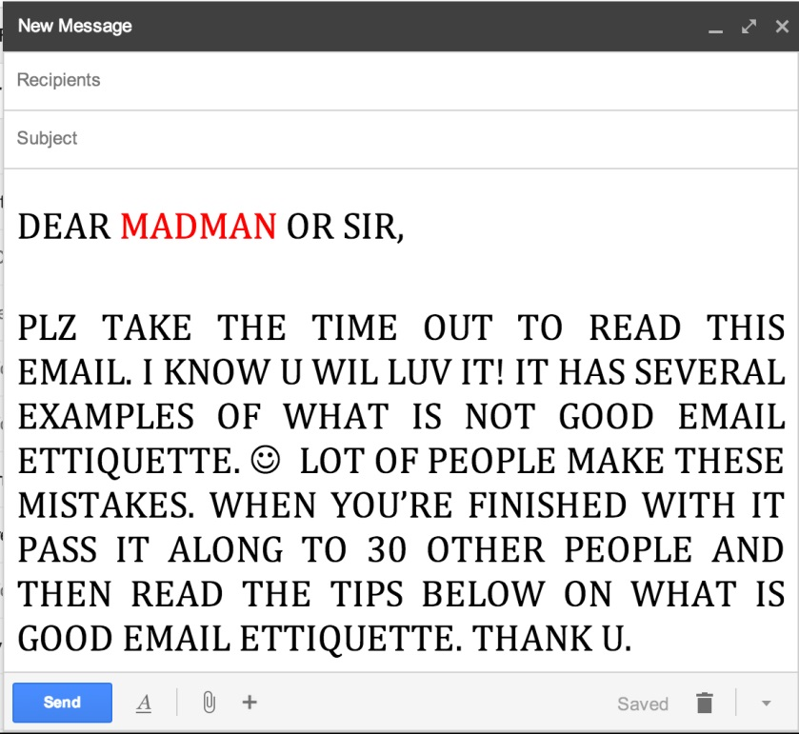
Workplace Basics
Using the Internet
E-Mail Etiquette
Use professional language
Limit personal topics
Avoid using contractions and symbols/emoticons
Include contact information with your signature
Always proofread before sending!
Use your time wisely
Familiarize yourself with company policy
Some companies may monitor use!

Slide 16
Continue Your Professional Development!
Networking is always important
Recognize mentors at and outside of work
Join a professional organization associated with your field and get involved in leadership positions
Keep yourself motivated by reflecting on your achievements
Remember, this job will most likely not be your last!
Notes:
Reflection is another way to beat the post-college blues!
Look forward to learning more about your career – it’s a big part of your life!

Slide 17
Quiz
Complete this online quiz to check your knowledge by clicking on the link & answering the questions
Throughout the semester, we will send out emails to complete this quiz for a chance to win a prize
https://forms.office.com/Pages/ResponsePage.aspx?id=IFyHJnWyD0WMgACyQ421GztZCWXX7PRKk4oe8BUmKAJURUdHUjJYRjJKUFVCU1BRTFdJNU4yMUo3Vy4u

Slide 18
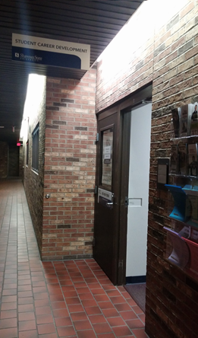
Contact
Student Career Development
Business Administration 036
(740) 351-3027
Careers@shawnee.edu

