Slide 1
Resumes & Cover Letters
Student Career Development
Business Administration 036
(740) 351-3027
Careers@shawnee.edu

Slide 2
Purpose
To get you an interview, NOT A JOB, by communicating your knowledge, skills and values.

Slide 3
Common Resume Mistakes
Typos!
Using words inappropriately
Not conveying job roles appropriately
Be specific!
Don’t get too creative, you want to exhibit professionalism

Slide 4
Style and Format
Font size
10 – 12
Even Margins
.5 inch-1 inch
Font style
Times New Roman
Calibri
Arial
Well-organized, attractive & easy to read
Consistent formatting

Slide 5
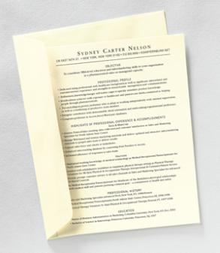
Style and Format
Style and Format (cont.)
Paper Color
White
Ivory
Light gray
Use resume paper!
FREE in the Student Career Development office (ADMIN 036)
Unfolded and mailed in a large flat envelope

Slide 6
Resume Style 1: Chronological
Are you a current student or recent graduate?
OR
Have you had continuous employment in your area of interest?
Consider making a Chronological Resume
A chronological resume presents your experience in reverse order, beginning with most recent/relevant experience.
Job achievements and skills are listed under each position
Presents experience under headings by job title, company, location and dates of employment
Format allows employers to easily determine work performed at each company

Slide 7
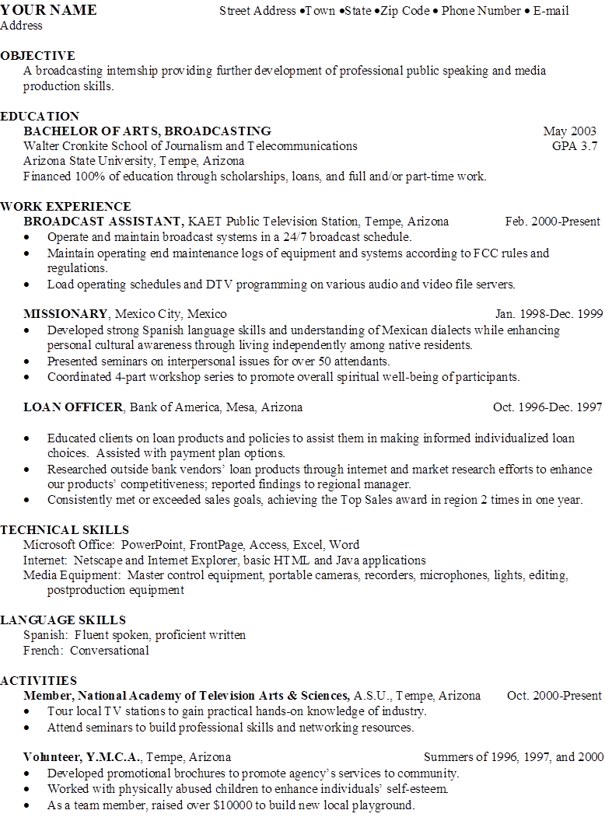
Chronological

Slide 8
Resume Style 2: Functional
Have you had several job changes or gaps in employment?
OR
Are you making a career change?
Consider making a Functional Resume
A functional resume emphasizes qualifications rather than work history.
Skills are listed according to categories using job-related skills.
Work experience is placed under different skill categories, not under specific positions. It is typically summarized at the end of the resume as well.

Slide 9
Functional
WARNING:
Be sure to highlight specific skills needed for the job

Slide 10
Resume Style 3: Combination
Do you already have significant experience related to a position?
OR
Are you making a career change?
Utilize a Combination Resume
A combination resume uses aspects from chronological and functional styles.
Typically begin with a professional summary or summary of skills (functional – related to the job you are applying for).
The focus of the resume is on job experience, not education.
May also include an additional skills section.

Slide 11
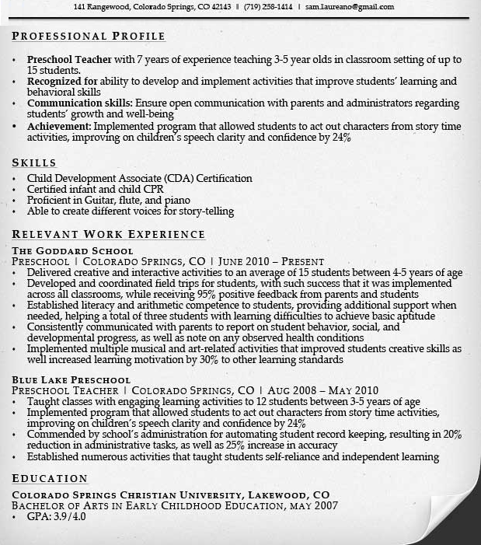
Combination
combination

Slide 12
Contact Information
Contact information
Minimal information
Full Name
E-mail address
Phone number
Optional information
Address
Additional Phone Number
URL Address
Make sure you are using a professional email!

Slide 13
Objective
An employer uses your objective to determine where you might fit within her/his department or organization.
Position based objective:
Financial Analyst Position
Industry based objective:
To obtain a full-time position in the field of information technology with an emphasis on technology integration.
Objectives are completely optional!

Slide 14
Organization and Headings
Suggestions for headings:
Education
Internships
Academic Coursework
Computer Skills
Relevant Experience
Honors
Language Skills
Leadership Experiences
Campus & Community Involvement
Professional Affiliations
Skill Summary
Licenses and Certifications
Military experience
Technical Skills
Laboratory Skills
Publications and Presentations
Avoid: “References available upon request” statement

Slide 15
Skill Statements Cheat Sheet
Action Word + Your Contribution
WHY you did it:
Example: Toured several local factories to explore the differences and similarities in their engineering perspectives.
HOW you did it:
Example: Increased reading comprehension using theoretical and evidence-based techniques.
RESULTS of the action:
Example: Implemented a survey which resulted in healthier drink options in the cafeteria.

Slide 16
Skill Statements Example
Use statements that emphasize achievements rather than duties.
What’s wrong with this?
Bartender, XYZ Bar, Tempe, AZ March 1999-present
Mix drinks
Stock bar
Order supplies
Close bar

Slide 17
Skill Statements Example
LEAD BARTENDER, August 2000-present
BARTENDER, March 1999-present
XYZ Bar, Tempe, AZ
Assist up to 300 customers during a four hour time period in a fast paced, stressful environment
Troubleshoot bar inventory issues, ordering supplies proactively to maintain appropriate inventory levels crucial for effective customer service
Problem solve and negotiate a diversity of customer service issues
Hire, train, and supervise bar staff of 6 in accordance with company customer service policies, procedures, and health/safety regulations

Slide 18
Proving Your Effectiveness
Describe what you actually DID, not just what was on the original job description
Include what IMPACT/ CONTRIBUTION your actions provided (the results)
Provide details
Supervised WHO and HOW MANY?
Analyzed WHAT? HOW?
Improved quality, efficiency, productivity HOW?

Slide 19
Using Action Verbs
Avoid starting phrases with “Handle…”, “Work with…”, “Duties included…”, “Responsible for…”
Start each bulleted statement with a descriptive action-oriented verb and combine with accomplishment statement
(Not this) Handled incoming telephone calls
(This) Directed up to 40 customer calls per hour to appropriate service departments throughout company

Slide 20
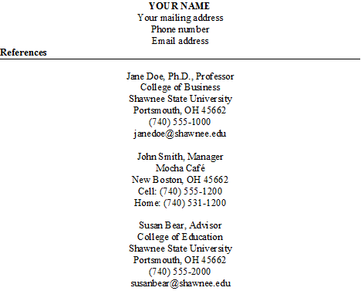
Sample Reference Page

Slide 21
Increasing Effectiveness
Maintain 100% error free
Tailor both resume and cover letter to each position and employer
Lead with most relevant information first
Avoid items that might promote negative bias
Use abbreviations only if standard and well-known
Keep to one page-unless you have a lot of relevant experience

Slide 22
Cover Letters
Purpose
Express your intent, interest, and enthusiasm in position
Complement and emphasize highlights of your resume
Demonstrate your personality and writing ability

Slide 23
Cover Letters - First Paragraph
State which position you are applying for, and how you found out about the organization and/or position
Express what is attracting you to work for this organization and in this position
Arouse the reader’s interest in reading more about your qualifications

Slide 24
Cover Letters - Second Paragraph
Give detailed information about how your qualifications fit with the position’s responsibilities
Use key words from the job description to make the connection between the employer’s needs and your skills
Include information about academics, job experience, and/or personal attributes relevant to the position

Slide 25
Cover Letters - Third Paragraph
Summarize your qualifications
Refer the reader to your enclosed resume
Mention your interest in an interview

Slide 26
Sample cover letter
Shawn E. Bear
940 Second Street
Portsmouth, Ohio 45662
Bears1@mymail.shawnee.edu
(740) 555-1234
January 15, 2016
Jaime Watts
Columbus Hospital Medical Center
123 Radiology Drive
Columbus, Ohio 43204
Dear Mr. Watts,
I am writing to express interest in the Intensive Care Unit Radiology Technician position. After coming across and reading the required qualifications listed in your advertisement in the Portsmouth Daily Times, I would like to introduce and present the reasons why I would be an excellent addition to your existing medical team at Columbus Hospital Medical Center.
I am currently enrolled in the Radiologic Technology program at Shawnee State University. I feel my coursework and clinical experience has provided me with the skills needed to fulfill the position you are seeking. I am also a strong communicator and enjoy the patient contact, always aiming to make their test procedures as reassuring and pleasant as possible for them. I am highly organized, good at being a member of a highly efficient and tight knit team who enjoys working in a precision related environment.
I would be excited for an opportunity to join the Radiology department at Columbus Hospital Medical Center, and am confident that I would become valued member of your team. Thank you for taking the time to review my letter and enclosed resume. I look forward to discussing the job requirements and my qualifications further in an interview. Please contact me by phone at (740) 555-1234, or by email at bears1@mymail.shawnee.edu with any questions.
Thank you for your time,
(Sign your name here)
Shawn E. Bear

Slide 27
Sample Cover Letter

Slide 28
Tips
DO use:
Industry specific ‘key’ words
Do NOT use:
Fancy scripts
Graphics or shading
Complex layouts and columns
Design or tool lines of any kind

Slide 29
Next Steps
Create a draft of your resume and cover letter
Use examples online to guide you and give you ideas.
Attend workshops hosted by the Student Career Development office.
Take your resume and cover letter to the Student Career Development office and/or the Writing Center for review.
Take your resume to a Resume Clinic.
Post your resume on Ohio Means Jobs.
Coming soon… SSU online career portfolio!

Slide 30
Quiz
Complete this online quiz by clicking on the link & answering the questions
There will be weeks during the semester where we send emails about a drawing for having the quiz completed by a certain date
https://forms.office.com/Pages/ResponsePage.aspx?id=IFyHJnWyD0WMgACyQ421GztZCWXX7PRKk4oe8BUmKAJUMkFJMEhONjA3QjZZUzlMM000MkNGVUVCWC4u

Slide 31
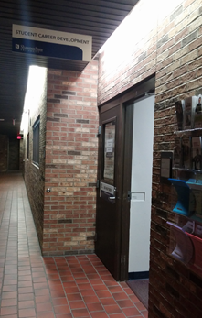
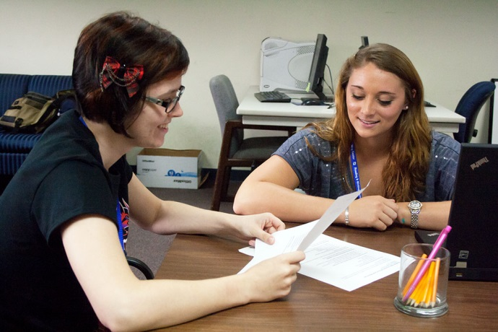
Contacts
Student Career Development
careers@Shawnee.edu
Writing Center, Library Room 120
*Adapted from Arizona State University*

