Slide 1
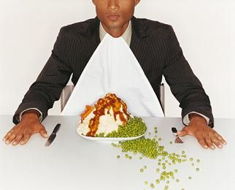
Dining Etiquette
Student career development

Slide 2
http://www.youtube.com/watch?v=qnydFmqHuVo
First impressions mean everything!
Notes:
Remember, you are not there just to eat!!

Slide 3
First Impressions Mean Everything
You never get a second chance to make a first impression.
Many people were never taught the fundamentals of dining etiquette.
….which way should I pass?
…which fork is mine?
…what do I do with my napkin?
Remember, the meal is an extension of the interview so put your best foot forward.
Notes:
Meals can be used to observe your behavior in social settings to see how you conduct yourself, particularly if the job for which you are interviewing requires a certain standard of conduct with clients.
You may be asked to lunch or dinner at a restaurant as a 2nd or 3rd interview. This may be out of convenience or so the interviewer can see you in a different setting.
These simple tips are great to know how to act when out to lunch/dinner/drinks with coworkers, leaders or clients. In a professional job setting, you are always being observed and slurping your soup is not the way to impress your boss!

Slide 4
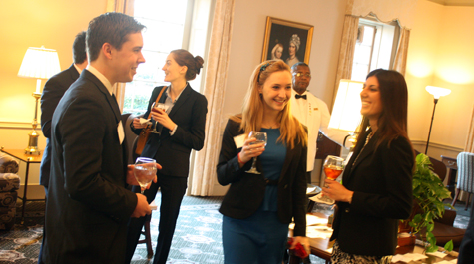
When You Arrive
What do you do if you arrive first?
Name Tag
When meeting someone…
…rise if you are seated.
…smile and extend your hand.
…repeat the other person’s name in your greeting.
Do not place any bags, purses, sunglasses, cell phones, or briefcases on the table.
Do not order one of the most expensive items on the menu if you are not the host.
The meal begins when the host or hostess unfolds his or her napkin. This is your signal to do the same.
Notes:
Be sure to greet or introduce yourself to the host/hostess. Spend a few minutes conversing with them on topics that relate to the event or to their business. To move on you can politely say I know you need to talk with your other guests. Make an effort to remember their name.
Wait until everyone is seated before eating.
If it is a cocktail hour, see if people are seated or standing. Never have food and a drink in your hand (one or the other, or use a table)

Slide 5
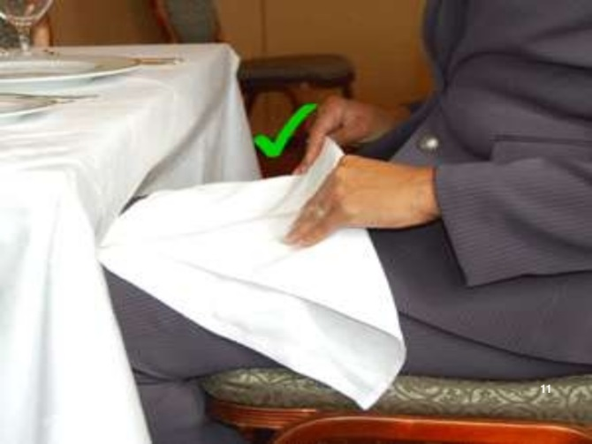
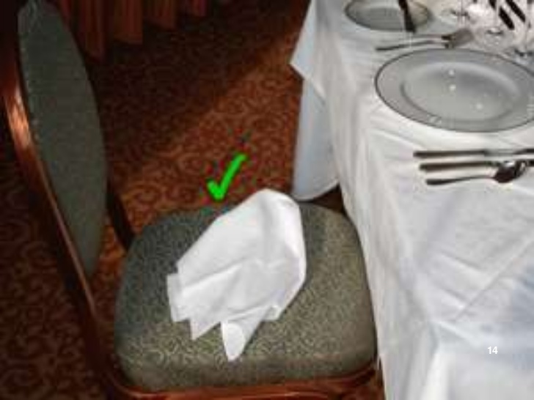
Napkins
Open the napkin below the table height
The napkin rests on the lap until the end of the meal.
Use it to dab the corners of your mouth.
NEVER use it to blow your nose!
If you need to excuse yourself from the table, loosely fold the napkin and place it to the left of your plate or on your chair.
At the end of the meal, leave the napkin semi-folded at the right side of the place setting. It should not be crumpled or twisted.
Notes:
Don't clean the cutlery or wipe your face with the napkin.
When excusing yourself - Do not refold your napkin or wad it up on the table.
Napkin goes in the lap once everyone at your table is seated

Slide 6
The Art of Eating
Wait until everyone is seated before eating and/or until your host takes their first bite.
When dining with others, everyone should start and finish at the same time.
Cut one piece at a time while taking small bites, keep your mouth closed and finish chewing before continuing your conversation.
Try not to gulp your food, it isn't very attractive.
Do not use a toothpick or apply makeup at the table.
Notes:
This will help you pace yourself. This can be difficult for people that are used to eating on the run.
Cut your meat or meal one piece at a time; avoid dicing it into bite-sized pieces all at once. Cut your salad into bite-sized pieces.
- this will also help you pace yourself

Slide 7
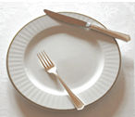
Silverware
A formal table setting can be overwhelming, but don’t panic!
Keep utensils in the same order they appear on the table.
If a piece of silverware drops, leave it and ask for a replacement from your server.
Silverware should not touch the tablecloth once used.
Between uses, place your knife and fork in the resting position.

Slide 8
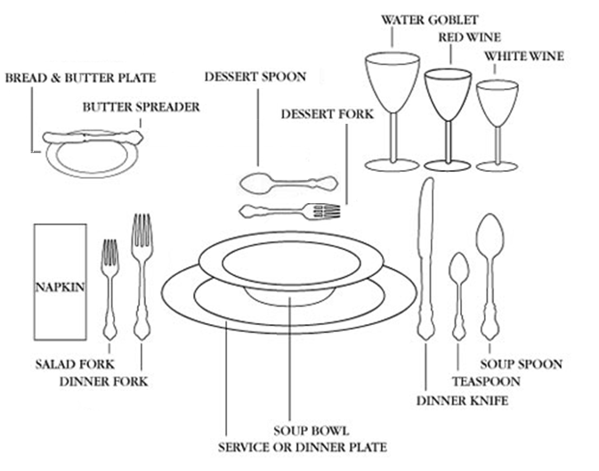
Formal Table Setting
Notes:
THIS SHOULD BE WHAT YOU ARE LOOKING AT .
If you remember the rule to work from the outside in, you'll be fine.
ORDER OF TODAY’S MEAL:
Salad & roll; soup; entrée; dessert
*Your salad and roll should already be set, and the subsequent plates and bowls will be brought out with their respective course.

Slide 9
Salad
Dining Etiquette when having salad
Notes:
THIS SHOULD BE WHAT YOU ARE LOOKING AT .
If you remember the rule to work from the outside in, you'll be fine.
ORDER OF TODAY’S MEAL:
Salad & roll; soup; entrée; dessert
*Your salad and roll should already be set, and the subsequent plates and bowls will be brought out with their respective course.

Slide 10
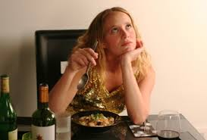
Posture
Sit up straight and try not to lean on the table.
Keep your elbows off the table and close to the body when you are eating.
Notes:
and keep your left hand in your lap unless you are using it.

Slide 11
Socialization
Connect with as many attendees as possible
Ask them about themselves or their job
Do not interrupt people
Do not bring up or engage in controversial conversation
Make sure you politely excuse yourself
During Dinner
Include others in your conversation
Talk about the food and wine, décor, music
If you are a junior member, don’t dominate the discussion
Notes:
Connect with as many of the attendees as is possible. That is why you are there!
To start conversations ask the person something about themselves or their job. You will find most people enjoy talking about themselves and this is a good way to begin conversation.
Do not interrupt people but wait until they include you or there is a break in the conversation and you can introduce yourself.
Do not bring up controversial topics. Avoid asking people about religious beliefs, financial info, illnesses, details about a divorce/affair, weight/height/age, harmful gossip
- Don’t tell racial, ethnic, or sexually-oriented jokes!!!
Do not be looking around the room for your next contact as you carry on a conversation with someone. Focus eye contact on that individual and after a time politely excuse you to move on to someone else.
DURING DINNER
- Make sure people near you are not excluded
- If you do not know those around you very well, talk about the food/wine, décor, music, or how they know the host
- Talk to people to your right and left of you
- Junior member: make comments and ask questions during business discussions
** You also want to make sure you are not only talking about business, unless it is the reason for a lunch/dinner

Slide 12
Beverages
Alcohol and Cocktail Hour
Do not drink alcohol unless your host orders a drink first.
Limited to 1 drink
Never cover glass if do not want a drink
Hold wine glass by stem in left hand
Toasts
Take sip when person giving the toast is finished talking
Coffee
Place spoon in tea saucer
Don't crunch ice!
Notes:
If you choose not to drink, never put your hand over your glass or turn it upside down. You may want to let the wait person pour your wine and then not drink it or just take one or two sips
COFFEE
Coffee mugs and saucers are typically not part of the place setting. Coffee may be offered with dessert after the meal.
Don't leave your spoon in the coffee cup or teacup or mug; place it on the saucer or a plate.

Slide 13
Soup
Notes:
THIS SHOULD BE WHAT YOU ARE LOOKING AT .
If you remember the rule to work from the outside in, you'll be fine.

Slide 14
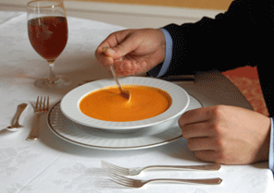
Soup Etiquette
Scoop using your soup spoon away from you
Sip from the side of the spoon, and avoid slurping.
You may tilt the bowl to scoop the remaining soup near the end.
Place spoon in bowl when you take break or are finished
https://www.youtube.com/watch?v=5m2gMM1rt70
Notes:
Add a few oyster crackers at a time to your soup. Keep saltines on your bread plate and eat them with your fingers, breaking one piece at a time. You may scatter shared croutons from the serving dish to your bowl of soup.

Slide 15
Main Course
Notes:
THIS SHOULD BE WHAT YOU ARE LOOKING AT .
If you remember the rule to work from the outside in, you'll be fine.

Slide 16
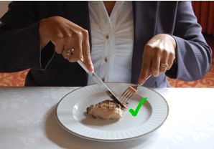
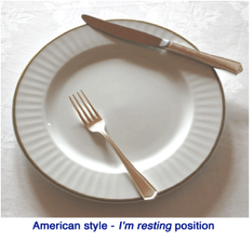
Using Your Silverware
If you are right handed:
Cut food by holding the knife in the right hand and the fork in the left hand with the fork tines piercing the food and facing downward to secure it on the plate.
Place the knife in the resting position, switch the fork to your left hand, and take the bite
Cut only enough food for the next mouthful
Lay your knife across the top edge of your plate with the sharp edge of the blade facing in.
If you are left-handed
Hold the knife in your left hand and fork in your right hand with the tines facing downward
Then, you place the knife in the resting position on the upper left corner of the plate, switch the fork to your left hand, and then take the bite.
https://www.youtube.com/watch?v=YIj5Rt-7b9I 1:42-2:07
(right handed)
Resting Position
Notes:
https://www.youtube.com/watch?v=YIj5Rt-7b9I
VIDEO 1:42-2:07
Change your fork from your left to your right hand to eat, fork tines facing up.
Be aware that there is a different style of using knives and forks (and different resting and finished positions) for other cultures (ex: English style).

Slide 17
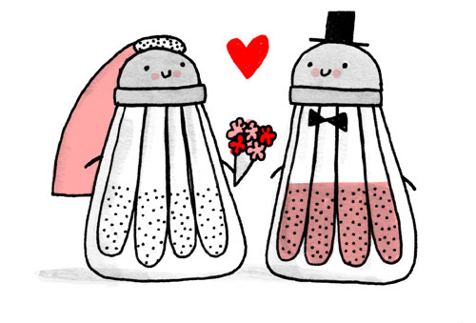
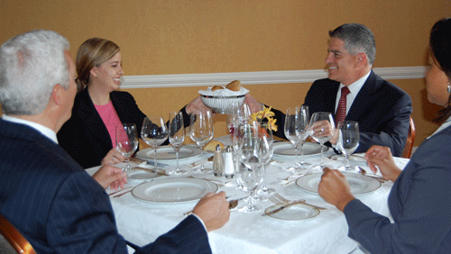
Passing and Sharing
Salt and pepper always travel together.
Transfer butter and dips to your plate.
Always pass shared items to the right.
No interceptions! Snagging a roll out of the breadbasket or taking a shake of salt when it is en route to someone else is a no-no.
Plates are served on the left. Dishes are removed from the right.
Notes:
Salt and pepper always travel together. Even if the person only asks for one of them. A popular phrase you may hear in dining etiquette is that salt and pepper are “married.”
Pass food to the right.
Transfer dip to your plate.
Plates are served on the left.
Dishes are removed from the right.
With seconds, there is NO specific passing order.

Slide 18
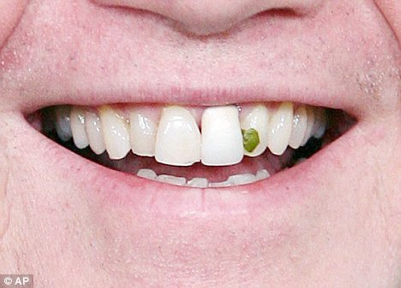
Overcoming Challenges
Be discrete if you have problem with the food.
Try a bit of everything on your plate!
Excuse yourself, if you have to leave the table.
Turn your head from the table when you cough or sneeze.
Do not blow on your food to cool it off. If it is too hot to eat, take the hint and wait.
Notes:
NEVER complain about the food or service
For hard to scoop items like peas, use your knife or a piece of bread to push the items onto your fork. Do not use your fingers.
If an accident at the table occurs, handle it and forget about it. It’s not necessary to drone on and on about the spilled tea in your lap. Try to divert the attention to something positive.

Slide 19
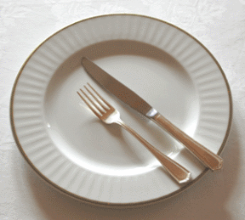
When You’re Finished…
Don’t push your plate away from you or stack up your dishes.
To signal that your are done with the course, rest your fork, tines up, and knife blade in, with the handles resting at five o'clock and tips pointing to ten o'clock on your plate.
Do not ask for a “doggy bag”.
Notes:
Be aware of your silverware’s resting and finished position.
It’s okay to leave some food on your plate or finish it all! However, if everyone has had their plate cleared, it is appropriate to have the server take yours as well.
In Europe and some Asian countries, it is customary to leave a couple bites of each part of the meal, as it indicates they did not give you enough food.

Slide 20
Dessert
Notes:
THIS SHOULD BE WHAT YOU ARE LOOKING AT .
If you remember the rule to work from the outside in, you'll be fine.

Slide 21
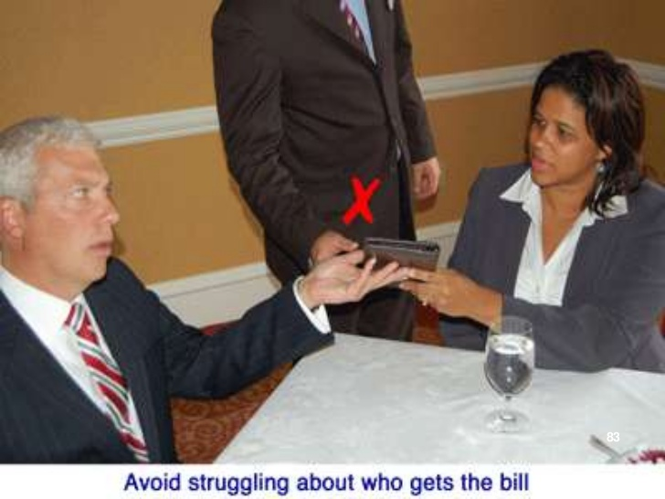
Paying the Bill
Don’t fight about it!
It is the responsibility of the host to reach and pay for the bill.
As a host you can:
Show up early and give credit card in advance
Tell your server (once you are seated) that the bill should be given to you.
If there is an error on the bill, do not try to argue with the server there.
Head to the server’s station to resolve the problem

Slide 22
General Tips to Remember
Be punctual!
Keep up-to-date on current events in your industry so you can have appropriate conversations.
Remember, the meal is part of the interview!
You can never say please and thank you enough, especially to the wait staff.
Upon leaving, be sure to say goodbye to and thank the host.
Notes:
Thank the host and maintain good eye contact.
You should leave with everyone else, or as appropriate at a large event. Never too early or right after finishing your meal.

Slide 23
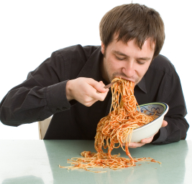
General Tips to Remember
Do not talk with your mouth full and chew with your mouth closed.
Eat in small bites and slowly.
Do not bring your cell phone!
Do not use a toothpick or apply makeup at the table.
Notes:
Ladies: be careful of wearing too much lipstick – you don’t want it to smudge your drinking glass.

Slide 24
Quiz
Complete this online quiz to check your knowledge by clicking on the link & answering the questions
Throughout the semester, we will send out emails to complete this quiz for a chance to win a prize
https://forms.office.com/Pages/ResponsePage.aspx?id=IFyHJnWyD0WMgACyQ421GztZCWXX7PRKk4oe8BUmKAJUQVdSWjJaSkNDUVMzQlBGNUhMSVdRVjVIOC4u

Slide 25
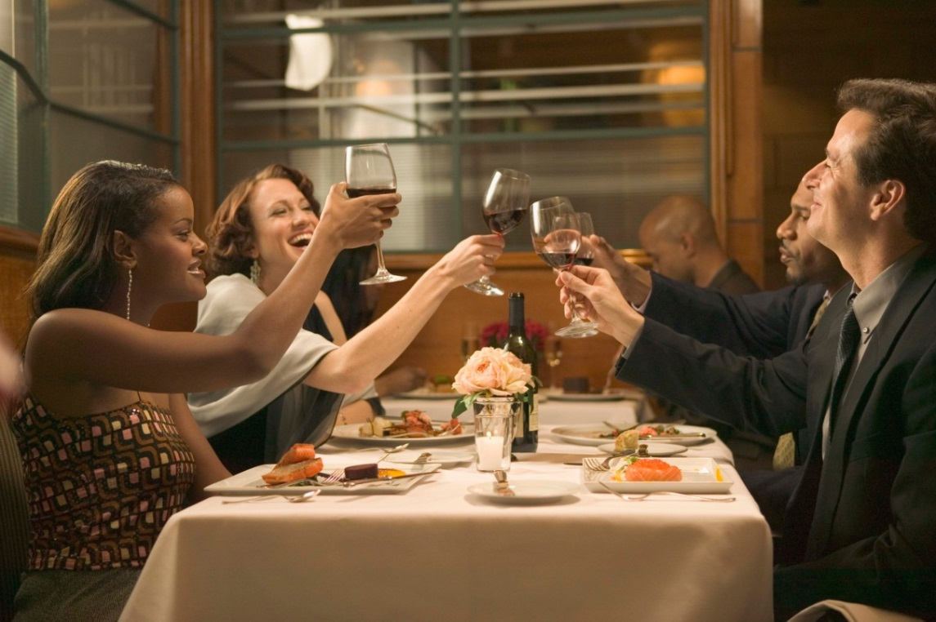
Practice Makes Perfect!
Bon appétit!
Labu apetīti
Smakelijk eten!
กินให้อร่อย
吃好
¡Buen apetito!
Mahlzeit!
Смачного!
Пријатно!
Thokoleza ukudla!
Practice proper dining etiquette at home and with your friends next time you go out to eat! The more you practice the more comfortable you’ll be in professional dining settings.
Notes:
Practice when you’re not embarrassed to make mistakes and are able to work them out with someone your are comfortable with!

Slide 26
References
Career Services. (2015). Dining Etiquette: A Guide to Professional Business Etiquette. Retrieved from Career Services: https://portal.utpa.edu/portal/page/portal/utpa_main/dsa_home/career_home/site_images_and_files/Dining%20Etiquette%202011_0.pdf
Lubin, G., & Bhasin, K. (2012, April 19). 29 Rules Of Etiquette For Your Next Business Lunch. Retrieved from Business Insider: http://www.businessinsider.com/rules-of-dining-etiquette-2012-4
Sabath, Ann Marie. Business Etiquette in Brief: The Competitive Edge for Today’s Professional. Holbrook: Bob Adams, Inc. , 1993. Print.
Windingland, D. (2011, December 20). Don’t be a Dinner Dope: Cheat Sheet for Dining Etiquette.
Retrieved from Small Talk, Big Results: https://smalltalkbigresults.wordpress.com/2011/12/20/dont-be
a-dinner-dope-cheat-sheet- for-dining-etiquette/
Dinning Etiquette Guide: Restaurant and Dinner Party Manners and Etiquette
http://whatscookingamerica.net/Menu/DiningEtiquetteGuide.htm
Sabath, Ann Marie. Business Etiquette in Brief: The Competitive Edge for Today’s Professional. Holbrook: Bob Adams, Inc. , 1993. Print.
http://www.slideshare.net/SMConsulting/dining-etiquette-12123953

Slide 27
Contact
Student Career Development
ADMIN 036
careers@shawnee.edu
(740) 351-3027

