Slide 1
BUDGETING & Managing Your money
Student Career Development
Business Administration 036
(740) 351-3027
Careers@shawnee.edu

Slide 2
Personal Budgeting Poll
Do you have a budget?
Do you have a checkbook?
Have you ever bounced a check?
Have you bought something this week without comparison shopping?
Have you bought a store brand, rather than a name brand item this week?
Do you have a savings account?
Have you added money to your savings account this week?
Do you pay your own car insurance…or part of it?
Do you routinely carry more than $10.00 in your purse or wallet?
Do you have a method of recording what you spend?

Slide 3
Budgeting
The numbers on that first paycheck can be tempting, but creating extra financial hardship will make the transition from college to work extra challenging.
Create a budget:
Identify spending habits
Take into consideration new expenses
Be careful with student-loan debt:
Understand your repayment options
Make payments on time
Do not take on other debt if possible
(i.e. credit cards, car loan, etc.)
Notes:
You can use old bank statements to find your spending pattern
Especially if you will be on your own for the first time, you will want to spend time balancing a budget.
Americans now owe more than $875 billion on student loans, which is more than the total amount that Americans owe on their credit cards
Approximately two-thirds of all college students graduate with student loans
Total student loan debt in the United States is now increasing at a rate of approximately $2,853.88 per second
Starting salaries for college graduates across the United States are down in 2010

Slide 4
Money Matters
How many times a day do you spend money?
The average person spends money 3 times a day
Just one soft drink a day for .99cents = $361.35/year
The biggest expense item for students? FOOD!
Money brings happiness; Money problems bring unhappiness
Finances affect everything else in your life!
$
Notes:
Money problems stay with you for the rest of your life
Top reason for divorce is financial.
Even fast food can add up!!

Slide 5
Income
Income is money earned.
Gross income=income before taxes.
Net income=income after taxes
Taxes can range from 15% to 30%.
I lose roughly 30% of my paycheck to taxes, retirement deductions and health insurance.

Slide 6
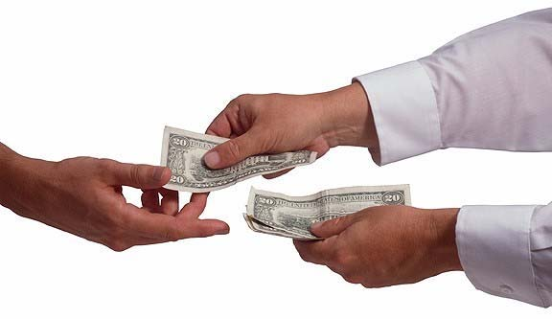
Understanding Income and Taxes
If your first job pays $30,000 a year… Your salary is your gross income.
Take off 30% for taxes and other deductions….
Your net income is $21,000
That’s $1750 a month
*Other deductions may include what you pay into your health insurance and other benefits

Slide 7
Savings
Savings is unspent income
Start saving now…..pay yourself first!
Use automatic transfers or payroll deduction when available.
Drop your change in a change jar or piggy bank.
Why save?
Emergencies: Plan to set aside at least 3 months’ living expenses
Long-term: Big items like a house, car or college
Retirement: …it’s never to early to start!
Short-term: Vacation, clothes, a new bike, going out to eat, ect.

Slide 8
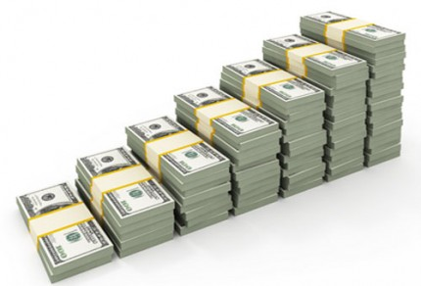
Start Saving Early!
If you invest $200 a month beginning at age 25 and you earn 7 percent annually on that money... by the time you turn 65, you will have about $525,000 saved up.
If you wait until you're 35 to begin saving, assuming the same monthly investment and rate of return, you'll accumulate less than half that amount – about $244,000.

Slide 9
Expenses (needs vs. wants)
An expense is a cost to meet a need or pay a debt.
Types of expenses: fixed, variable and discretionary
Needs are essential expenses
Food
Shelter
Clothing
Transportation
Wants are extra expenses
Eating out
Expensive houses or cars
Shopping until you drop
The newest technology…..whether it’s an iPhone, iPad, Kindle, etc.

Slide 10
Fixed Expenses
A cost that occurs regularly and doesn’t vary in amount.
Rent or Mortgage
Car payment
Insurance
School loans
Cell phone
Cable/Internet
Others?

Slide 11
Variable Expenses
Costs that occur regularly but may vary in amount.
Electricity
Water
Gas
Groceries
Others?

Slide 12
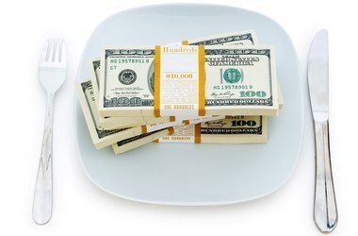
Discretionary Expenses
A cost determined by personal wants that can be controlled.
Movies, videos, music, et cetera
Sports
Eating out
Grooming and clothes
Concerts and plays
Vacation
Credit card
Others?

Slide 13
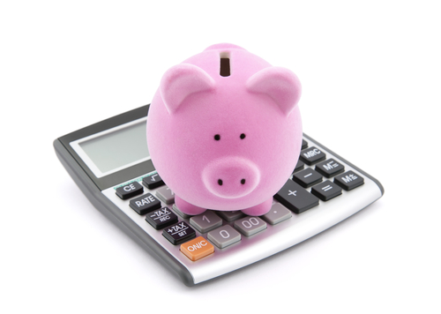
What is a Budget?
….what is a budget?
A plan for spending and saving money that flows in and out of your household every month.
Why is a budget important?
Budgeting is the first step on the road to financial success
A budget will help you set priorities and achieve what is important to you.
Start budgeting now! Don’t wait until you’re “on your feet” to create a budget.

Slide 14
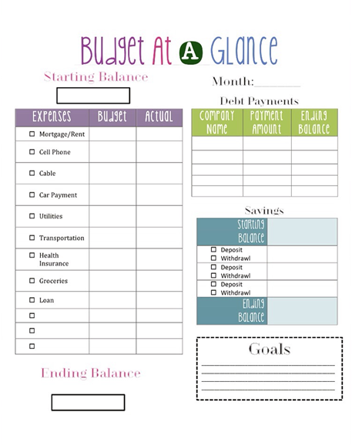
Where to Start
If you’ve never budgeted before, start writing down everything you spend money on.
What do you have to spend?
What are you buying that isn’t a necessity?

Slide 15
What is Included in a Monthly Budget?
How does the typical family spend their money?
Food 22%
Transportation 14%
Mortgage/Rent 14%
Utilities, Home Improvements 14%
Clothing 10%
Other 9%
Medical/Dental 8%
Recreation 7%
Personal 2%

Slide 16
Ways to Improve Your Finances
Make more money
Cut your expenses
Example: Reduce your grocery bill
Make a shopping list
Study grocery ads
Buy store brand products
Avoid impulse purchases
Learn the basic prices of your favorite foods
Determine your budget

Slide 17
Quiz
Please complete the quiz by answering the questions correctly.
We will send emails regarding a drawing that will select students with the highest grade to be awarded with prizes!
https://forms.office.com/Pages/ResponsePage.aspx?id=IFyHJnWyD0WMgACyQ421GztZCWXX7PRKk4oe8BUmKAJUODQzTThBVUlOS1lDOEhMWE9QWUlXVUFWVy4u

Slide 18
Student Career Development Business Administration 036 (740) 351-3027 Careers@shawnee.edu
References: http://www.businessinsider.com; http://www.bankrate.com; Utah Education Network; University of Arizona; Service Credit Union

