Slide 1
Your Career Development Starts Now:
student career development
Admin 036
Careers@Shawnee.edu
(740) 351-3027

Slide 2
What is Career Development?
Career development is a process throughout the duration of your role as a student of self-assessment, career exploration, career decision-making, and implementation.

Slide 3
What Services Does the Office of Career Development Offer?
Career and Major Exploration
Skills and Personality Indicator Assessment Tools
Skill Building
Internship, Job and Graduate School Search
Resume and Cover Letter Development
Free Resume Printing Services
Interview Practice
One-on-one Career Counseling

Slide 4
Freshman Year
Adjust to college life.
Select courses of interest.
Identify your interests, skills and values.
Get involved with clubs and organizations.
Build relationships with students, faculty and staff.

Slide 5
Sophomore Year
Declare a major and concentration.
Gather occupational information.
Onet, Focus 2, Buzzfile, Occupational Outlook Handbook
Seek volunteer and leadership opportunities.
Explore career-related experiences such as internships and professional practice through volunteer work.
For more information, email internships.now@shawnee.edu

Slide 6
Junior Year
Update your resume and identify gaps in your professional profile.
Ohio Means Jobs & LinkedIn
Practice your interview skills.
Broaden your horizons through multicultural and community service experiences.
Expand your volunteer activities.
Gain practical work experience through internships and professional practice.
Develop networking relationships through alumni contacts, internship or professional practice experiences and career fairs.
Meet with an academic or career advisor to develop a transition plan for senior year.

Slide 7
What’s a Transition Plan?
Have you decided what career path to pursue with your degree?
Will you graduate on time?
Are you interested in doing an internship?

Slide 8
Senior Year
Implement your transition plan.
Make sure you upload your resume to LinkedIn & Ohio Means Jobs.
Utilize your career network to find potential opportunities.
Put your job search and interview skills into action!
Attend job fairs to line up interviews with potential employers in your field.
Jobapalooza & JobFest

Slide 9
Important Contacts
Student Career Development (Administration 036)
Student Career Development Staff, Careers@shawnee.edu
Multicultural Affairs (UC 222)
Justin McMillan, jmcmillan@shawnee.edu
Coordinator, Multicultural Affairs & Student Life
Student Activities (UC 222)
Tiffany Hartman, thartman@shawnee.edu
Director, Student Life
Your Academic Advisor (?)
Student Success Center (Massie Hall)
Center for International Programs and Activities
Ryan Warner, rwarner@shawnee.edu
Director, Center for International Programs & Activities
Library
ssulibanswer@mymail.shawnee.edu
Student Business Center (UC 240)

Slide 10
Quiz
Complete this online quiz by clicking on the link & answering the questions
There will be weeks during the semester where we send emails about a drawing for having the quiz completed by a certain date
https://forms.office.com/Pages/ResponsePage.aspx?id=IFyHJnWyD0WMgACyQ421GztZCWXX7PRKk4oe8BUmKAJUNVZLNkJLNlY1OTNIWldWWllSVEhEWUNPNi4u

Slide 11
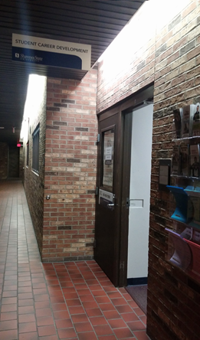
Student Career Development
Business Administration 036
(740) 351-3027
Careers@shawnee.edu

