Slide 1
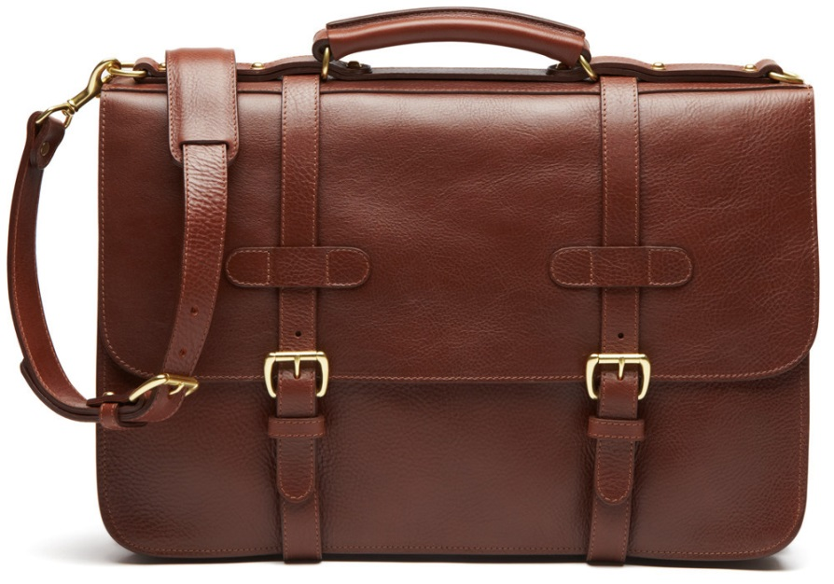
Dressing for Success
Kelsey Douglas
Student Career Development
PeerCareer@shawnee.edu
(740) 351-3027

Slide 2
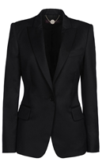
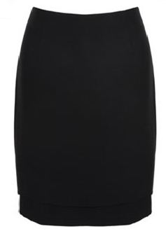
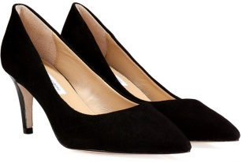
The Basics
Stick to neutral, solid colors
Accessorize to dress up different pieces
Stay professional
Wear something you feel good in!
Try setting aside outfits for the week

Slide 3
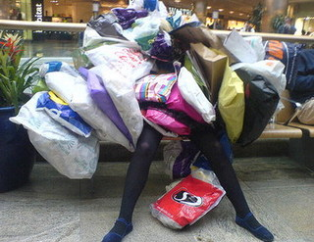
When Buying New Items
Quality over Quantity
Ask for items as gifts
Shop sales!
Browse consignment and thrift stores
Let others know you are revitalizing your wardrobe
Think about material before buying (will it need to be dry cleaned?)

Slide 4
Hygiene
Body Odor
Take a shower!
Wear deodorant
Minimal perfume/cologne
Breath
Well-brushed and fresh breath
Don’t eat foods that will leave an odor
Do not chew gum or eat mints during an interview!

Slide 5
Appearance
Hair
Well-groomed
Don’t use too much product
Men – Get a hair cut 3-5 days before (if needed)
Make-up
Minimal/natural
Facial Hair
Neatly trimmed
Remove piercings
Fingernails
Cleaned and trimmed (1/4 inch past finger tips)
Ladies - Clear polish
Clothing
Clean and ironed
** Arrive early and check your appearance

Slide 6
Men
Make sure your suit is tailored
Button only one or two buttons
Wear a long-sleeved shirt
A briefcase makes a great accessory!
Wear a tie with “classic” colors
Your shoes, belt, and socks should match
Jewelry should be limited

Slide 7
Women
Suit
Conservative dark black, navy, dark gray, brown or tan wool-blend suit
Skirt length should be a little below the knee
Business dress with matching jacket is okay
Blouse
Tank-top style or tailored shirt—should be cotton or silk and should be white, or some other light color
Pantyhose?
Always—it should be the color of your skin and flawless
Purse or briefcase?
Opt for a briefcase or just a leather pad folio
It should be the same color as your shoes
Shoes
Low heels, 2 inches or less—no spike heels.

Slide 8
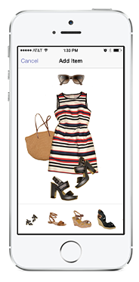
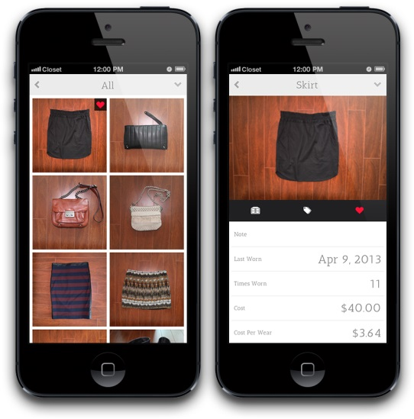
Extra Tips
Use an app to help you match and organize your wardrobe!
Stylebook, Pose, Closet
If you are struggling with what to wear – ask someone that you feel has good fashion sense.

Slide 9
Questions? Contact us or visit our office for more information!
Student Career Development
Shawnee State University
ADMIN 036
PeerCareer@shawnee.edu
(740) 351-3027

